Slide 1
AI-POWERED REAL ESTATE MARKETPLACE & PROPERTY MANAGEMENT SYSTEM
Secure, Smart and Legally Compliment Real Estate Transcation
WINTECH
MUSKAN SAHANI
HANSIKA KANSAL
VAIDEHI KATIYAR
SHREYA SINGH
ADARSH RAJ

Slide 2
Problem Statement
Real Estate Challenges:
-Fraudulent Transactions: Fake listings, title fraud, and misleading property details.
-Legal Complexities: Buyers/Sellers face contract disputes, tenants experience lease issues.
-Inefficiency: Delayed maintenance requests, lack of transparency in lease agreements.
- Security Concerns: Payment frauds and unauthorized property transactions.
Why Existing Solutions Fail:
- Lack of integrated legal support for property transactions.
- Inefficient property management tools that don’t address legal aspects.

Slide 3
Our Solution
- AI-Powered Online Real Estate Marketplace for property discovery & transactions.
-Smart Property Management System to automate tenant applications, leases & maintenance.
-AI-Driven Legal Assistance to generate contracts, assess risks & provide legal guidance.

Slide 4
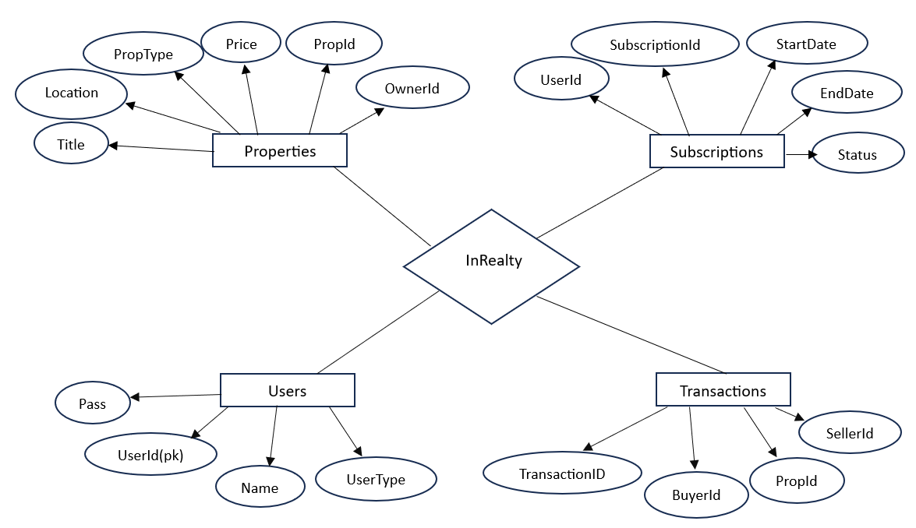
Visual Representation

Slide 5

Key Features - Real Estate Marketplace
01
02
03
AI-Driven Property Search & Recommendations
Virtual Property Viewings & Online Scheduling
Secure Digital Transactions & Verified Listings

Slide 6
Key Features - Property Management System
01
02
03
Automated Tenant Application & Screening (Background & credit checks)
AI-Powered Lease Agreement Generation
Maintenance Request Tracking & Automated Work Orders

Slide 7
Legal AI - The Game Changer
- AI-Powered Contract Generator: Auto-generates sale deeds, lease agreements.
- AI Chatbot for Legal Queries: Helps with tenant rights, property laws.
- Contract Risk Assessment: AI scans agreements for potential legal issues.
- Blockchain Integration: Secure & immutable property records.

Slide 8
Competitive Advantage
Feature | Existing Platforms | Our AI-Powered Solution
Property Search | Manual, limited filters | AI-driven personalized recommendations
Legal Support | Requires external legal aid | AI contract generator & legal chatbot
Property Management | Basic tools | Automated tenant applications & maintenance

Slide 9

INREALTY
An online real estate marketplace
www.inrealty.com

Slide 10
Market Opportunity
- Global Real Estate Market Size (2024):$9.6 trillion. (Statista)
-Online Real Estate Market CAGR (2024-2030): 13.1% Growth (Market Research Future)
-Property Fraud Cases:Over $1 billion lost yearly in fraudulent transactions. (FBI)
-Legal Disputes in Real Estate: 30% of all civil court cases involve real estate issues.

Slide 11
FUTURE ROADMAP
Phase 1
Phase 2
Phase 3
Phase 4
MVP Launch with AI-powered contracts & property management
Advanced AI chatbot & legal compliance automation
Blockchain for Smart Contracts & Secure Transactions
Expansion into global markets with localized AI

Slide 12

Impact & Scalability
01
02
Future partnerships with legal firms & real estate agencies
Potential to scale across different countries with localized legal AI.
www.inrealty.com

